Slide 1
Appreciative Inquiry
A Model for Organizational Change
“A Brief Introduction”
KROLL BOND RATING AGENCY, INC

Slide 2
Introduction
What is AI?
A Model for Organizational Change
An insight into human behavior
Why am I presenting it?
DevOps
Personal Growth
Personal Enjoyment

Slide 3
5-Step Problem Solving Process
Identify the problem
Analyze the problem
Identify possible solutions
Implement the solution
Evaluate
Notes:
A more performant and simpler version: Take T1’s until you get T5’, take T5’s until you get T20’s, always take T20’s. Highly performant.

Slide 4
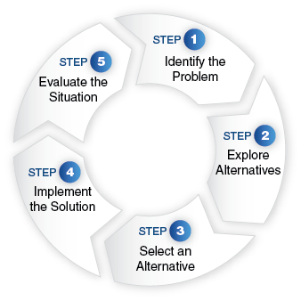
5-Step Problem Solving Typical Image
Notes:
A more performant and simpler version: Take T1’s until you get T5’, take T5’s until you get T20’s, always take T20’s. Highly performant.

Slide 5
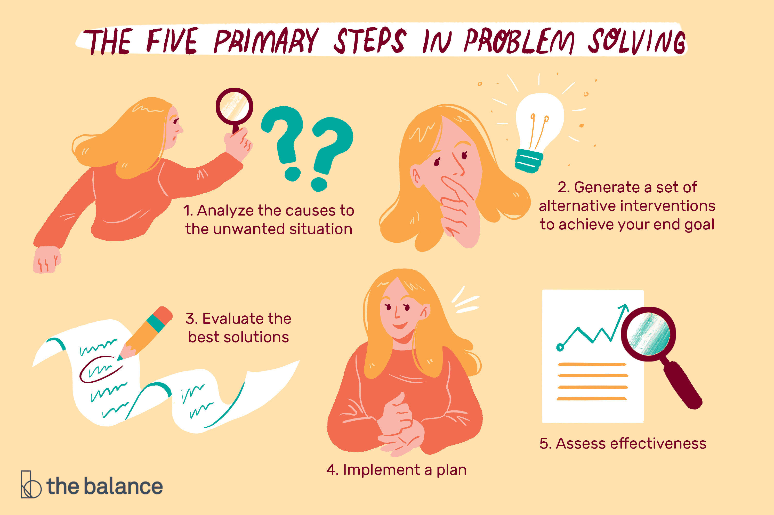
5-Step Problem Solving a Fun Image
Notes:
A more performant and simpler version: Take T1’s until you get T5’, take T5’s until you get T20’s, always take T20’s. Highly performant.

Slide 6
5-Step Problem Solving a Fun Image
Notes:
A more performant and simpler version: Take T1’s until you get T5’, take T5’s until you get T20’s, always take T20’s. Highly performant.

Slide 7
Summary
I hope I have provided:
Support for the DevOps initiative
A non-tech path for Developer growth.

